Slide 1
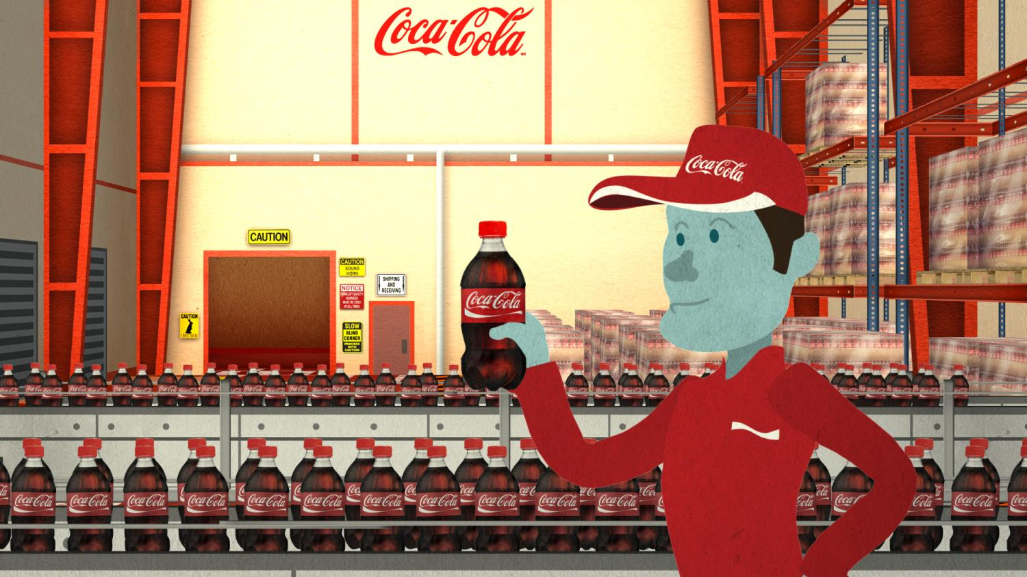

CLIMATE AMBASSADOR TRAINING
Module 1: 2020 CLIMATE TARGET & ROLE OF AMBASSADORS
in partnership with
Notes:
Welcome everyone to our Climate Ambassador workshop brought to you by The Coca-Cola Company and our partner the World Wildlife Fund.

Slide 2


WHY ARE WE HERE?
in partnership with
Notes:
Why we are here?

We are here today to talk about how each of us help the company to reach the 2020 Goals – specifically our carbon commitment defined within our Me, We, The World promise.

Slide 3
GOAL REDUCE THE CARBON FOOTPRINT OF THE ‘DRINK IN YOUR HAND’ 25% BY
2020
in partnership with
Notes:

That goal – to reduce the carbon of the drink in your hand by 25% will be a steep challenge – but one that is critically important for our company as a corporate goal. Fulfilling this goal will require CHANGE. “If we always DO what we always DID, we’ll always GET what we always GOT.” That’s a consistent theme from our senior leadership.

Slide 4

WWF CLEAN ECONOMY: Financial Times Ad Dec/18 (final official day of COP15)
CHANGING
HOW WE
DO BUSINESS
Notes:
In 2009, our CEO said to the world: ”When it comes to climate change, the time has come for us to do more than mind our business.”
You can see this in the advertisement that we and WWF ran in the Financial Times (and also the Copenhagen Post) for the WWF during the U.N. Climate Conference in 2009. (The ad highlighted WWF’s Let the Clean Economy Begin campaign.)
Simply reducing our OWN emissions is no longer sufficient: minding our own business is not going to get the job done. We cannot continue to focus purely on the emissions from Manufacturing (which we now know are less than 10% of our total, end-to-end carbon footprint). Instead, to achieve a 25% reduction of the carbon footprint for the drink in your hand, we, like most global beverage companies, will need to look beyond our facilities to work along our full value chain. We will need to exhibit influence beyond those elements where we have direct control.
We do this because we are changing the way that we do business – because we seek to be good corporate citizens. And because it’s good for business.

Slide 5





EXPANDED
END-TO-END FOCUS
INGREDIENTS
PACKAGING
MANUFACTURING
DISTRIBUTION
REFRIGERATION
Sweeteners
Fruit, Tea,
Coffee, CO₂
Primary
Secondary
Fuel
Electricity
Trucking
Fleet
Logistics
Refrigerants
Electricity
CO₂e
13%
38%
9%
8%
32%
“GROW THE BUSINESS NOT THE CARBON” 2015
Notes:
Focusing in manufacturing alone will not get us to our goal. Let’s drill down into that a bit more.
This slide shows the proportion of our total end-to-end emission profile from 5 key segments of our value chain. You can see that emissions from Manufacturing represent only 9% of the total end-to-end emissions. You can also see that >50% of emissions come from upstream supply of Ingredients and Packaging.
Over the next 2 days, we will discuss how to influence change in each of these segments.

Slide 6





SHIFT IN GOAL FROM
ABSOLUTE to INTENSITY
INGREDIENTS
PACKAGING
MANUFACTURING
DISTRIBUTION
REFRIGERATION
Absolute Emissions
2010:
59 million
metric tons
2020:
72 million
metric tons
+13 million
metric tons
+22%
Carbon Footprint “Drink in your hand”
2010:
412 g CO₂e/l
2020:
311 g CO₂e/l
101 g CO₂e/l
-25%
Notes:
On additional comment is relevant here. Our current goal for Manufacturing (“Grow the Business, Not the Carbon”) is an Absolute target – to get total emissions back to 2004 level by 2015.
Our 2020 goal moves us from measuring “Absolute” Emissions to our “Carbon Intensity” – in other words reducing per liter of product.
The base year (2010) emission intensity was 412 grams/liter so fulfilling the commitment means the emission intensity in 2020 has to be below 311 grams/liter.
You will note below that the absolute emissions will actually increase over this period (to 72 MM metric tons). But the comparable BAU forecast would be 95 MM metric tons. So the net effect of our commitment is to prevent some 23 MM metric tons in 2020 (and over 100 MM metric tons cumulatively between now and then).
Working along our value chain also means we will need to learn how to operate outside of our sphere of control, working alongside our suppliers, distributors, and partners to jointly tackle the challenges and opportunities of reducing climate impact.

Slide 7

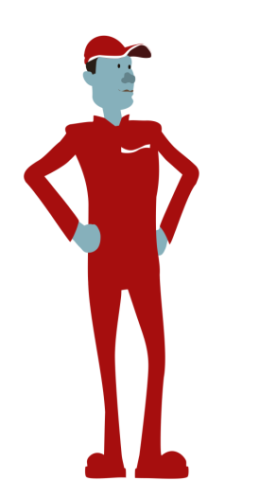
WHAT IS A CLIMATE AMBASSADOR?
EXPERT, ADVISOR, CHANGE AGENT
LEADER
Effectively communicates 2020 value-chain climate goals
EXPERT
Understands key opportunity areas
CHANGE-AGENT
Engages suppliers
INNOVATOR
Defines a strong business case for action
VALUE-CREATOR
Creates business and sustainability value
Notes:
Working along our value chain also means we will need to learn how to operate outside of our sphere of control, working alongside our suppliers, distributors, and partners to jointly tackle the challenges and opportunities of reducing climate impact.

This is a big challenge; and in addition to partners like WWF, we will need a strong group of leaders to carry us forward through a period of changing practice. We are very accustomed to being able to control our projects. That’s much harder when working with external parties.

That’s why we’re here today – to inaugurate our cohort of system leaders - our Climate Ambassadors. As Climate Ambassadors, we will be leaders

experts

change agents,

Innovators

and
value creators, guiding colleagues to blaze our way forward to our carbon goals.
Together we will help transform the company into a leader in carbon performance, creating more value for customers, our shareholders, our communities, our employees, our suppliers, and our bottom line.

Slide 8
LEADERS IN OUR SYSTEM
ROLE OF THE CLIMATE AMBASSADOR
Engage with BUs to deliver this material and address questions
Together with BUs engage top bottlers to deliver this material and address questions
Support BU and bottlers in supplier engagements
Gather feedback from BUs and bottlers and provide it to Corporate
Actively participate in the process to establish year on year targets though 2020
Participate in a follow-up web session in 1Q 2014 to report progress on the above
Notes:
Climate Ambassadors are strong voices in the System who will be leaders in transforming the business to meet changing market demand and environmental opportunities—for the bottom line and to meet our mission. Climate Ambassadors also support the process for establishing local goals.
In terms of concrete actions, Climate Ambassadors are expected to:
Engage with BUs to deliver this material and address questions

Together with BUs engage top bottlers to deliver this material and address questions

Support BU and bottlers in supplier engagements

Gather feedback from BUs and bottlers and provide it to Corporate

Actively participate in the process to establish year on year targets though 2020

Participate in a follow-up web session in 1Q 2014 to report progress on the above
And we’ll challenge ourselves to insert one clear objective inside our organization’s strategic plan that will measure us on these activities.

Slide 9


TRAINING OBJECTIVES
Effectively Communicate 2020 Climate Goals
Equip Yourself with Strong Business Case for Action
Understand Key Opportunity Areas
Learn to Engage Suppliers
Provide Feedback on Scenario Planner
Notes:
Today, we’ll take our first step in joint learning.
Learn to effectively Communicate the 2020 Climate Goals

Equip ourselves with a Strong Business Case for Action

Understand Key Intervention Areas across Ingredients, Packaging, Manufacturing, Distribution, 
Refrigeration

Learn to Engage Suppliers

Provide Feedback on Scenario Planner

Slide 10
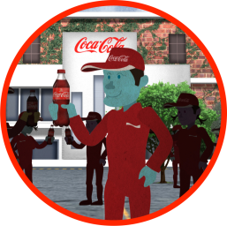
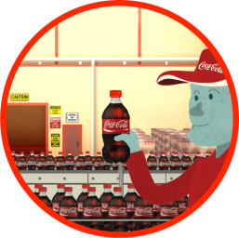


TRAINING AGENDA: LEADERS
CLIMATE AMBASSADORS
MODULE 1: INTRODUCTION
MODULE 2: BUSINESS CASE
MODULE 3:
IN ACTION
MODULE 4:
ENGAGEMENT
MODULE 5:
SCENARIO PLANNER
• WHY WE ARE HERE
• GOALS • TRAINING OBJ. • DISCUSSION
• BUSINESS STRATEGY
• REVENUE • RISK
• REPUTATION
ME, WE, WORLD
• STRATEGIC FRAME
• KEY INTERVENTIONS
• INGREDIENTS
• PACKAGING
• MANUFACTURING
• DISTRIBUTION
• REFRIGERATION
STEPS FOR ENGAGING SUPPLIERS
REVIEW SCENARIO PLANNER TOOL
PROVIDE FEEDBACK
Notes:
The Climate Ambassador training was developed to train experts in our system to help
Introduction: The 2020 Climate Target and the Role of Climate Ambassadors
STRATEGIC BACKGROUND
The Coca-Cola Company is expanding its carbon targets from manufacturing to encompass additional scope 3 elements across the broader supply/value chain, including upstream (ingredients and packaging) and downstream (distribution and refrigeration). The Company has adopted a new target to reduce the carbon footprint of the “drink in your hand” over this decade (2010-2020). This shift will require an additional set of capabilities to deliver on the new targets. For example, our employees will need to reach outside of their sphere of business control to partner with suppliers on emissions reductions projects –like reducing fertilizer use in our corn/sugar/citrus supply, reducing packaging, reducing fuel intensity in distribution, etc.
As part of building a new set of capabilities, the World Wildlife Fund partnered with The Coca-Cola Company to train a corps of Coca-Cola Climate Ambassadors as internal spokespeople and champions of climate innovation along the supply chain.

Slide 11
EXERCISE
Write down all of the carbon reduction opportunities you see in the video.
Notes:
EXERCISE
Divide into two groups
Individually, write down as many carbon reduction opportunities as you see in the video
In your groups, discuss, come up with a comprehensive list of all those different opportunities you saw

Slide 12
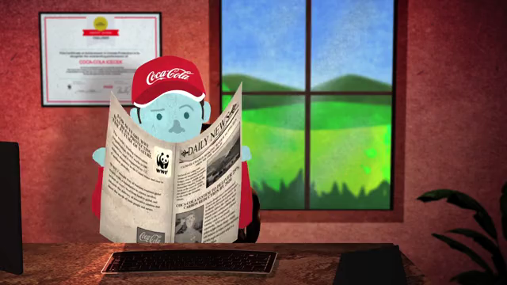
Notes:
VIDEO WILL BE EMBEDDED.
Right after the video, how many opportunities for emissions reductions can you remember from the video?

Slide 13
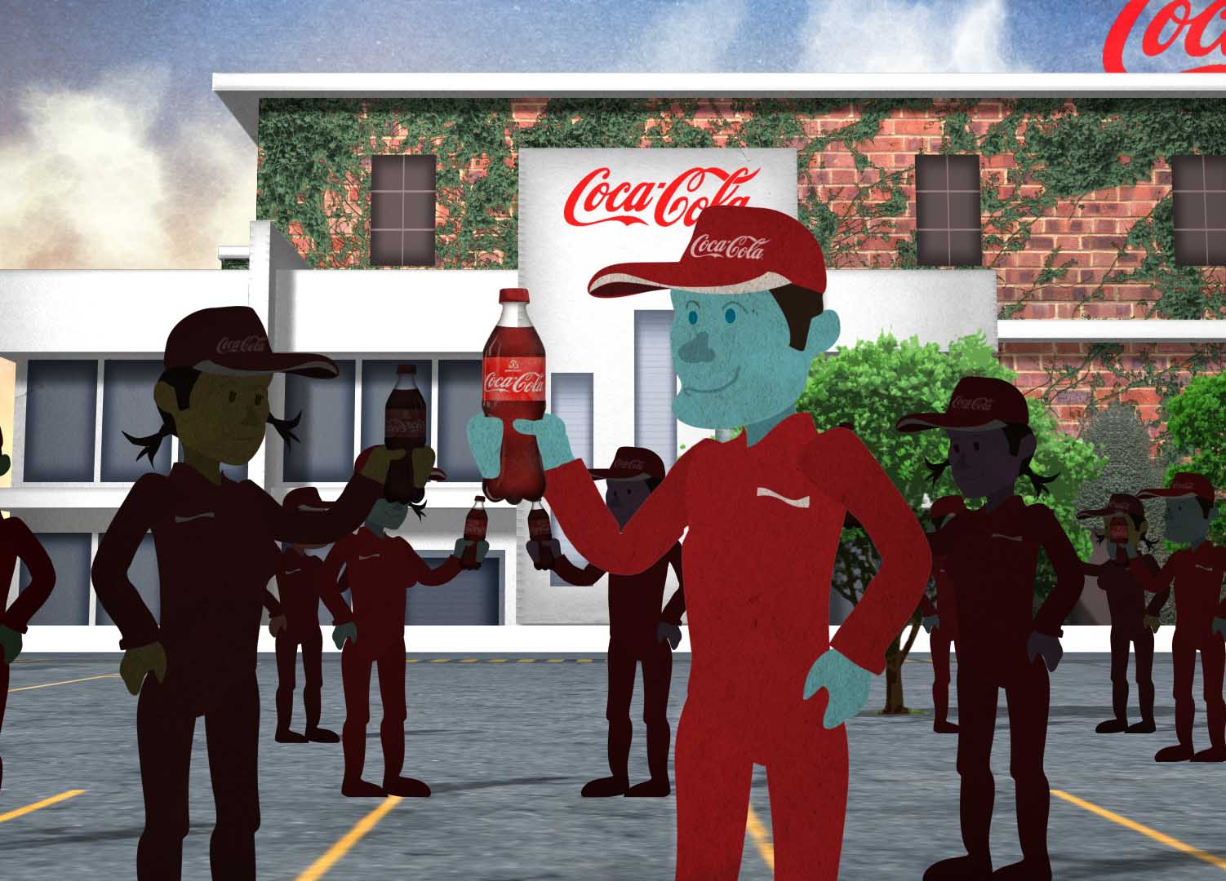
WHAT DOES THAT MEAN FOR
CLIMATE AMBASSADORS
Notes:
What does that all mean for Climate Ambassadors? This program was designed so that a core group of leaders can catalyze Coca-Cola’s action along the value chain.

Slide 14
CCESC
CLIMATE WORKSTREAM
TEAM MEMBERS
Jake Backus, Sustainability Director, Customer & Commercial Leadership
Tim Copeman, Group Environmental Manager, Coca-Cola Hellenic
Richard Crowther, Manager of Sustainable Energy, Coca-Cola Refreshments
Lucinda Hensman, Associate Director, CRS Communications, CCE
Alfredo Illescas, (former) Environmental Director, Coca-Cola Femsa
Bryan Jacob, Director of Climate Protection, Office of Sustainability
Ben R. Jordan, Director of Supplier Sustainability, GSP
Mario LaTorre, Environmental Director, Coca-Cola Andina
Carlos Pacheco, Energy Efficiency Manager, SES/CTO
Ulrike Sapiro, Corporate Responsibility and Sustainability Director, EUG
Mitsuru Shibata, SES Governance Manager, Japan BU
Klaus Stadler, Director of Environment & Water Resources, Europe Group
Rudi Sueys, Environment Manager – Energy, Europe Group
Kota Takasugi, PAC Environmental Performance Manager, Japan BU
Yukihiko Yoshimura, Environmental Director, Coca-Cola West (Japan)
Note: CCESC NextGen Climate Targets Team also sought input and support from the established Energy & Climate NETWORK.
Notes:
Congratulations being part of this inaugural Climate Ambassador team. Thank you again for participating in this training. Before continuing, let’s recognize our partners and the group of individuals across the system who have invested time and energy to help us develop our strategies and meet our goals. This slide lists the team who worked over the course of 18 months to help shape the new 2020 climate commitment.
The team includes:
Jake Backus, Customer Sustainability Director, Customer and Commercial Leadership
Tim Copeman, Group Environmental Manager, Coca-Cola Hellenic
Richard Crowther, Manager of Sustainable Energy, Coca-Cola Refreshments
Lucinda Hensman, Associate Director, CRS Communications, Coca-Cola Enterprises
Alfredo Illescas, (former) Environmental Director, Coca-Cola Femsa
Bryan Jacob , Director of Climate Protection, Office of Sustainability
Ben R. Jordan, Director of Supplier Sustainability, Global Sustainable Procurement
Mario LaTorre, Environmental Director, Coca-Cola Andina
Carlos Pacheco, Energy Efficiency Manager, Safety and Environmental Sustainability
Ulrike Sapiro, Corporate Responsibility and Sustainability Director, Europe Group
Mitsuru Shibata, SES Governance Manager, Japan BU
Klaus Stadler, Director of Environment & Water Resources, Europe Group
Rudi Sueys, Environment Manager – Energy, Europe Group
Kota Takasugi, PAC Environmental Performance Manager, Japan BU
Yukihiko Yoshimura, Environmental Director, Coca-Cola West (Japan)
And beyond this internal team, WWF is a critical external partner. Let’s now review our ambitious and important partnership with WWF, and our work in carbon reduction through WWF’s Climate Savers program.

Slide 15
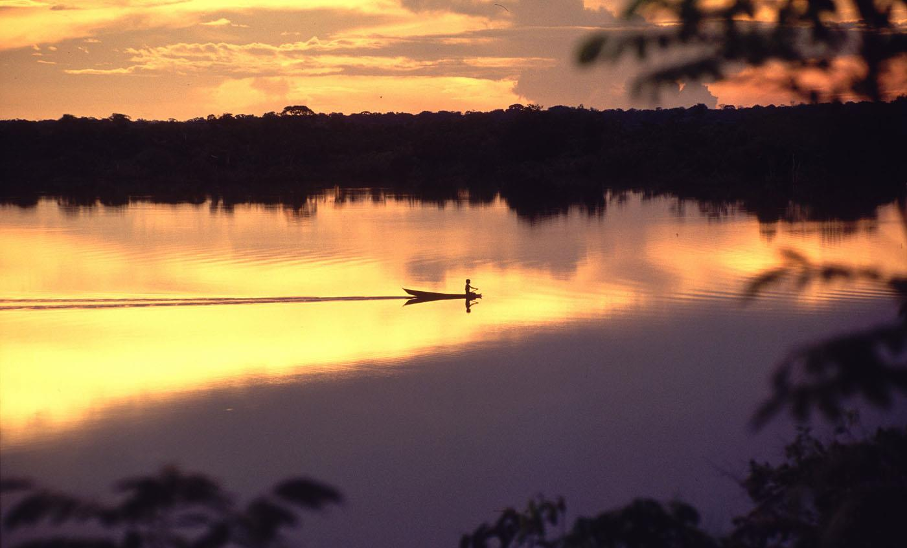
BETTER EARTH. BETTER BUSINESS.
© Juan Pratginestos / WWF-Canon
Notes:
Good Morning and on behalf of WWF, welcome to the Climate Ambassador Orientation.
My name is Matt Banks and I am a Manager in the Business & Industry team at WWFUS. I have managed our corporate engagement on climate change since 2002.
We are very excited to be a part of this workshop and we’re thrilled to be embarking on this next phase of partnership with Coca Cola. WWF has a long history of working with business and I will provide some perspective now on what we do and some of the megatrends we want our partners to have an understanding of.

Slide 16
WWF MISSION
Conserve nature and reduce the most pressing threats to the diversity of life on Earth.
© Michel Roggo / WWF-Canon
Notes:
The WWF mission statement has been consistent since the 60s. We are a global voice for conservation and leverage our brand to address conservation challenges in three areas -- species, spaces, and threats (deforestation, over-fishing, climate change, etc.).

Slide 17
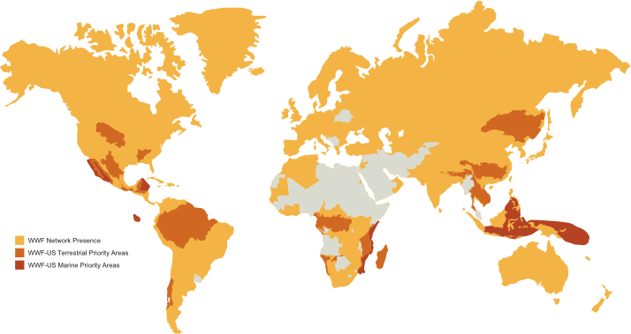
WWF WORK IS GLOBAL Presence in 100 countries.
Notes:
WWF has projects and staff in 100 countries and our network is similar to the Coke system.
There is some steering that comes from the Secretariat in Geneva, but each office has some autonomy in the global network.

Slide 18
WWF and business
We develop innovative global conservations strategies that meet the needs of people and the planet.
© Roger Leguen / WWF-Canon
Notes:
We develop innovative global conservations strategies that meet the needs of people and the planet.
We work in the field, in the boardroom, and in the halls of world capitals to bring stakeholders to the table to develop innovative strategies and solutions. Why do we do this?

Slide 19
Extinction is Forever
We have lost 30 percent of biodiversity since 1970.

Slide 20
The Challenges Are Tremendous
By 2030 we will need two planets
to support the way we are living.
Notes:
Source: Living Planet Report 2012
According to forecasts, the global urban population will almost double to 6 billion by 2050 (UNFPA, 2007)

Slide 21
Resource Scarcity Hurts Profits
Natural resource depletion threatens supply chains, and surging costs cut into business profits
Notes:
Business is vulnerable to the impacts of climate change, not at some point in the future, but now… This year was a good sampling of impacts. Climate change is a real and current threat.

Slide 22






























30+ Companies Cut
100 million tons of CO₂ since 1999
annual emissions of
WWF works with companies to
reduce impacts
value chain
champion innovative and sustainable solutions
harness marketplace as a force for conservation.
Notes:
Many companies are early actors and are leading the way but we want to challenge all sectors to set aggressive new reduction targets and target innovative new ways to meet those goals

Slide 23
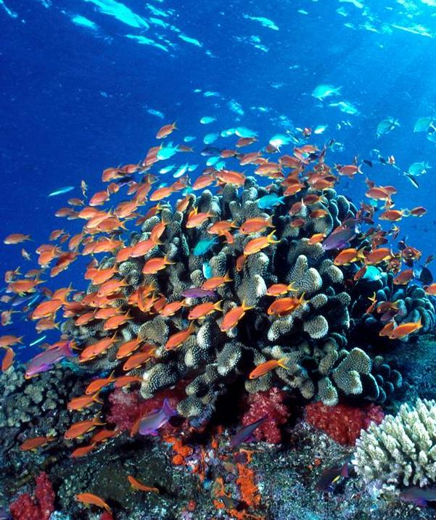


THE POWER OF OUR PARTNERSHIP
+
=
Conserve15 of the world’s most ecologically important regions by 2020
© Cat Holloway / WWF-Canon
Notes:
The power of our partnership is clear.
Together, by 2020, we will conserve 15 of the world’s most ecologically important regions by 2020

Slide 24
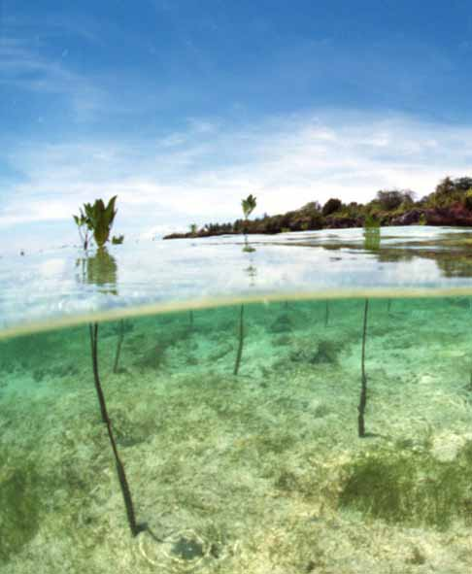
HIGHLIGHTS &
ACHIEVEMENTS
TO DATE
HIGHILIGHTS AND ACHIEVEMENTS
TO DATE
Ongoing restoration, education and protection activities in freshwater basins spanning Asia, Africa, Europe and the Americas
20% improvement in Coca-Cola’s water efficiency system-wide (since 2004)
Emissions levels in developed countries are 9% below 2004 baseline emissions
Bonsucro certification standard for growing and milling sugarcane
Inspired collaborations between local WWF and Coca-Cola offices in 49 countries

Slide 25
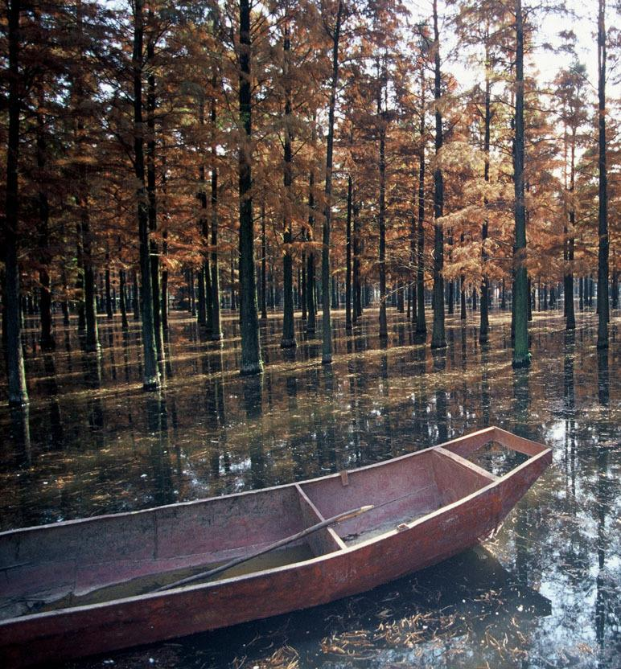
OUR COMMON GOALS
Through our Water+ commitment, we will:
Help ensure healthy, resilient river basins in 11 key regions
Measurably improve environmental performance across the company’s value chain
Integrate the value of nature into public and private decision-making processes
Convene influential partners to strengthen and amplify our work

Slide 26
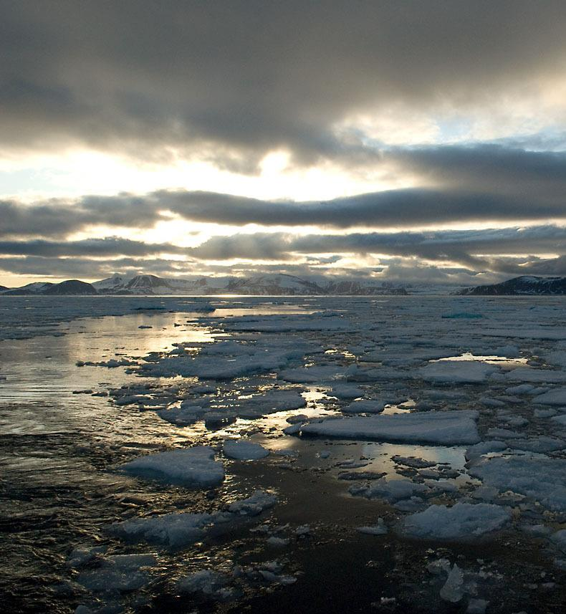
ENVIRONMENTAL PERFORMANCE TARGETS
WWF and Coca-Cola worked together to set these targets:
Climate Protection: 25% reduction of GHG emissions embedded in Coca-Cola’s drinks
Renewable Packaging: assess environmental and social performance of plant-based materials for potential use in renewable packaging
Sustainable Sourcing: sustainable source key agricultural ingredients
Water Efficiency: improve water efficiency in Coca-Cola’s manufacturing operations by an additional 25%
© Steve Morello / WWF-Canon
Notes:
Climate Protection: Coca-Cola will reduce the carbon embedded in its drinks 25 percent.
Renewable Packaging: Coca-Cola will work with WWF to assess the environmental and social performance of plant-based materials for potential use in renewable packaging. This will enable the company to meet its goal of using PlantBottle™ packaging in all of its PET plastic bottles.
Sustainable Sourcing: Coca-Cola will work to sustainably source its key agricultural ingredients, including sugarcane, sugar beets, corn, tea, palm oil, soy, pulp and paper fiber, and oranges. The Company has established Sustainable Agriculture Guiding Principles and will work with WWF to implement the guidelines throughout the Coca-Cola system for these commodities.
Water Efficiency: Coca-Cola will improve water efficiency in its manufacturing operations by an additional 25 percent through operational improvements across the Coca-Cola system, based on 2010 water efficiency levels. This target complements the 21.4 percent improvement in water efficiency that it achieved from 2004 through 2012.

Slide 27
DISCUSSION
Notes:
Discussion.
(Instructors can lead their own discussions, or, if they prefer can use these sample questions:
What questions do you have about the goals we set?
The methods for getting there?
Who has ideas for how to leverage our bottlers to help set ambitious goals?
What questions do you have about the role of the Climate Ambassador?
What ideas do you have?
Is there anything missing?
Who would be great at this? (Think through marketing, sales, procurement departments)
How many of you feel like you could become an expert Climate Ambassador?

